Slide 1



Day 24
contact@anubhavtrainings.com
ABAP RESTFUL APPLICATION PROGRAMMING

Slide 2

Agenda – Day 24
Creating AMDP
Limitations of ABAP on Cloud
What is RAP (Restful Application Programming Model)
Flow of Restful Application Programming
Evolution of ABAP Programming Model
Important Table’s
Types of Scenarios
Managed Scenario
Unmanaged Scenario
Flow of Development (Unmanaged Scenario)
Defining CDS Views
Creating OData Service ( Business Service)

Slide 3
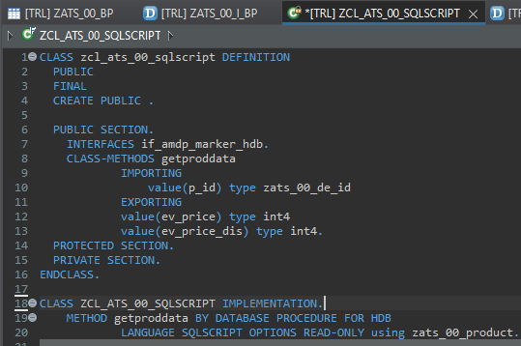
Creating AMDP
Exercise
Create AMDP

Slide 4

Limitation’s of ABAP on Cloud
It is an offering by SAP in SAP BTP platform as ABAP Platform as a service, which has limited capability.
https://blogs.sap.com/2019/08/20/its-steampunk-now/
We cannot use SAPGUI to connect to this system
We do not have control to install patches and add-on, snote
It is not an environment of any SAP ERP solutions
All the ABAP dictionary objects are marked as non-released
SAP’s actual product is S/4HANA, so all the classical extensions will be carried out in S4 itself.
You cannot create a program type of object
The AOC allows only usage of whitelisted abap statements, we cannot freely use every abap programming keyword.
Note : Eclipse environment can be used to connect to ABAP Environment in SAP Cloud platform

Slide 5

Restful ABAP Programming
The ABAP RESTful programming model defines the architecture for efficient end-to-end development of intrinsically SAP HANA-optimized OData services (such as Fiori apps) in SAP Business Technology Platform ABAP Environment. It supports the development of all types of Fiori applications as well as A2X services. It is based on technologies and frameworks such as Core Data Services (CDS) for defining semantically rich data models and a service model infrastructure for creating OData services with bindings to an OData protocol and ABAP-based application services for custom logic and SAPUI5-based user interfaces .
The whole architecture is based on
CDS views – will helps you to create semantically rich data model.
Business Object here is a node inside a tree data structure which is achieved by using root keyword at CDS view level, this is needed only if we want to add transactional capability.
Finally create a service using service definition and service binding .
The binding will confirm the Purpose of service – API or Fiori.
UI layer with the Fiori app using elements.

Slide 6
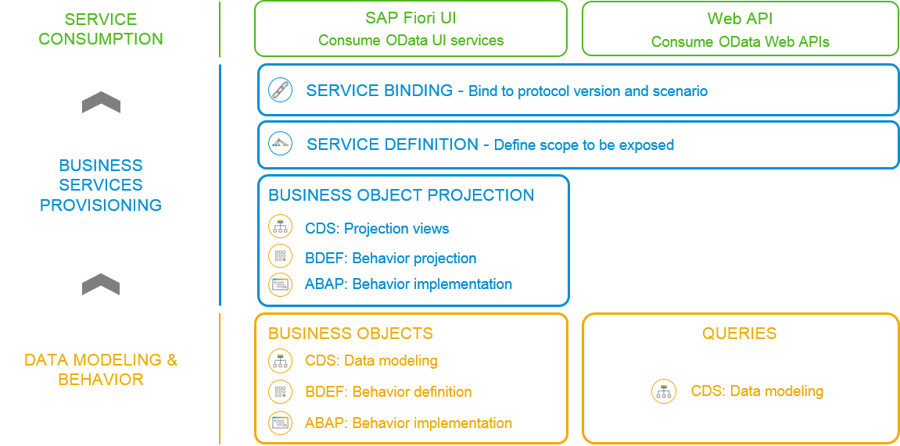
Flow of RESTful Application Programming

Slide 7
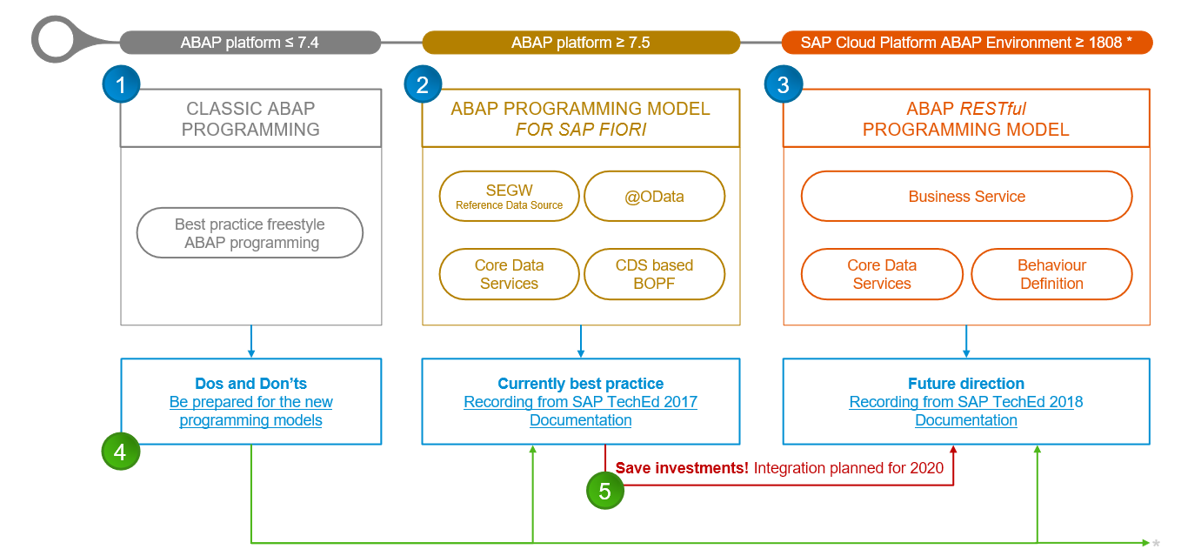
Evolution of ABAP Programming Model

Slide 8
Important Tables
CDS Views on these table for ease of access
Database tables
Represents entire aviation tourism
/DMO/CARRIER– Contains all the airline codes
I_Currency
CDS view to access currency codes
/DMO/AGENCY
Agent information website/person who helps
/DMO/CONNECTION– FLIGHT infor from origin to destination
I_Country
Country codes
/DMO/TRAVEL
Trip information
/dmo/flight– given flight for diff. dates
/DMO/CUSTOMER
Customer data who willing to book flights
/DMO/BOOKING
Connecting flights in whole travel

Slide 9
Types of Scenario
Brownfield Implementation
Is used when we want to create a transactional application which can insert, update, delete data from the system by writing your own logic
You already have Business logic with you and you want to use that business logic to perform transactional capability
You are own your own to manage your implementation.
02. Managed Scenario
Greenfield Implementation
Is used when we want to create a transactional application which can insert, update, delete data from the system by using the framework provided implementation
You do not have Business logic with you and you want system to create business logic for you automatically.
01. Un-Managed Scenario

Slide 10

BO runtime implementation types
INTERACTION
SAVE
Unmanaged
PHASE
SEQUENCE
For brownfield developments with available application code for
interaction phase, transactional buffer, and save sequence
finalize
➔
Developers in charge of BO runtime: CRUD operations
check_before_save
➔
Adapters needed to integrate the existing code
MODIFY
adjust_numbers
READ
LOCK
Managed
save
For greenfield developments with standard implementation
(
o
pt. unmanaged appl. components: DB tables, lock/PFCG object, update
task FM)
Transactional
➔
Standard CRUD operations work out of the box
buffer
Developers add BO
SAP HANA
➔
-
specific business logic
BUSINESS OBJECT RUNTIME

Slide 11
Flow of Development (Unmanaged Scenario)
Fiori UI
Service Binding for UI
Service Definition
Travel – Using /demo/travel
Projection view- what we want to show to UI
1
N
I_Currency
1
N
N
Agency
Customers
I_Country

Slide 12
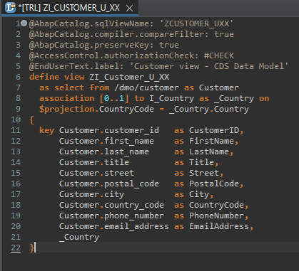
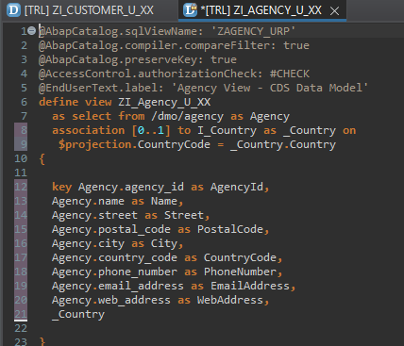
Defining Data Models
Create Customer CDS View “ZI_Customer_U_XX”
Create Agency CDS View “ZI_Agency_U_XX”

Slide 13
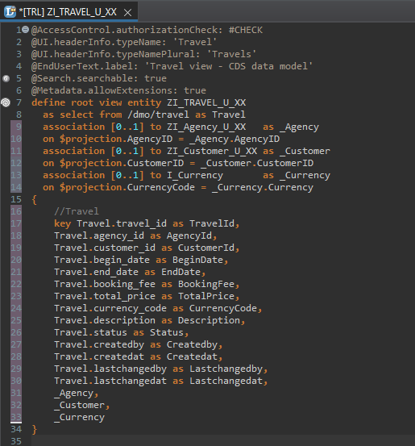
Root CDS Entity
On top of Customer and Agency CDS View we Create Root CDS View Entity called “ZI_TRAVEL_U_XX”.
With Annotations like Metadata ,Search ,
Semantic Annotation etc.
Association to Agency ,Customer , Currency.

Slide 14
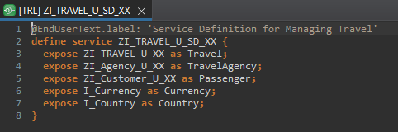
Create OData Service ( Business Service )
A business service definition (short form: service definition) describes which CDS entities of a data model are to be exposed so that a specific business service, for example, Sales Order handling, can be enabled. It is an ABAP Repository object that describes the consumer-specific but protocol-agnostic perspective on a data model. “ZI_TRAVEL_U_SD_XX”
CDS Entity
Service Definition
Service Binding

Slide 15
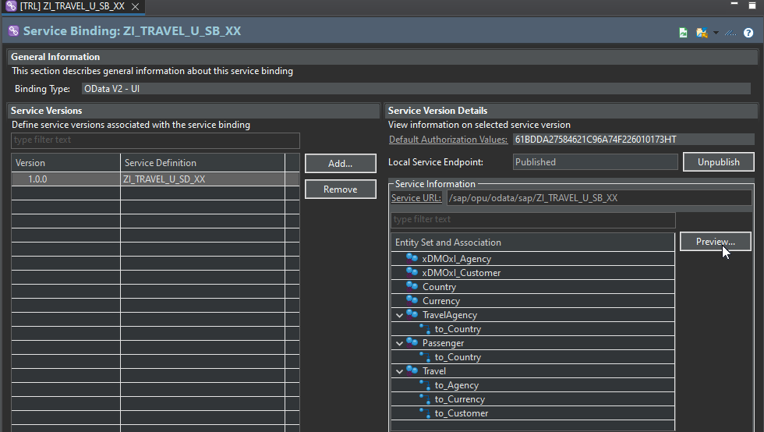
Service Binding ( Business Service )
The business service binding (short form: service binding) is an ABAP Repository object used to bind a service definition to a client-server communication protocol such as OData. Like any other repository object, the service binding uses the proven infrastructure of the ABAP Workbench, including the transport functionality.

Slide 16

End of Day 24
Trainer: Anubhav Oberoy

Slide 17

Trainer: Anubhav Oberoy

Slide 18
THANK YOU
If you cannot do
great things, do small things in a great way.
Anubhav Oberoy
https://www.anubhavtrainings.com

Slide 19


We’re committed to empower you to be
Most Desirable Resource
through powerful training solutions.
We build the workforce of the future.
250+
Corporate Clients
30,000+
Learners Trained
25000+
Learners Placed
FREE WEBINARS
Sign up for free webinars with industry experts every fortnight!
Enroll Now!
Contact us today!
https://anubhavtrainings.com/

Slide 20




More from AnubhavTrainings.com

